Slide 1

The Virtual Private Cloud (VPC) Part II adding security groups
Using AWS

Slide 2
About
Install apache2 on the server.
Change the security groups to allow traffic into our instance.
Create a Amazone RDS Instance.
Create a MySQL database that listens on port 3306.
Establish communication between Amazon EC2 Instance and Amazon RDS Instance in a secure connection.
Using Database Inbound Rules for the Security Group Server.
Add outbound rule to allow traffic to the database security group.
Install MySQL client, add an outbound rule on port 80 to allow the install of MySQL client.

Slide 3
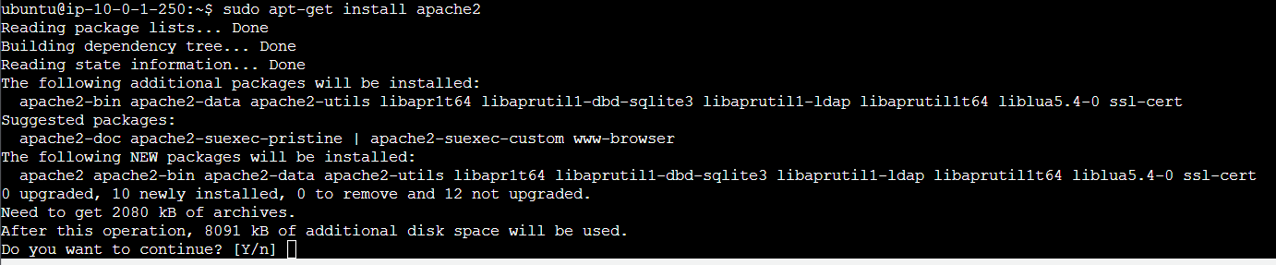
Update the server with the sudo apt-get update command.
Next, we install apache2 and type yes and enter to continue.

Slide 4
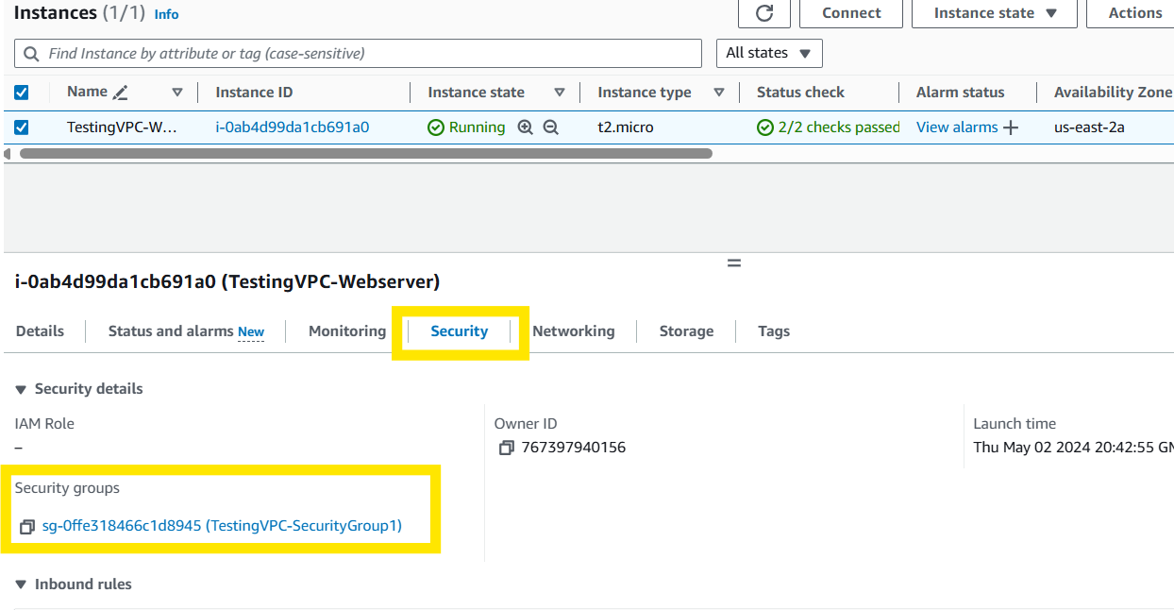
Verify the apache2 service started.
Go to your Instances in AWS and click on your security groups.

Slide 5
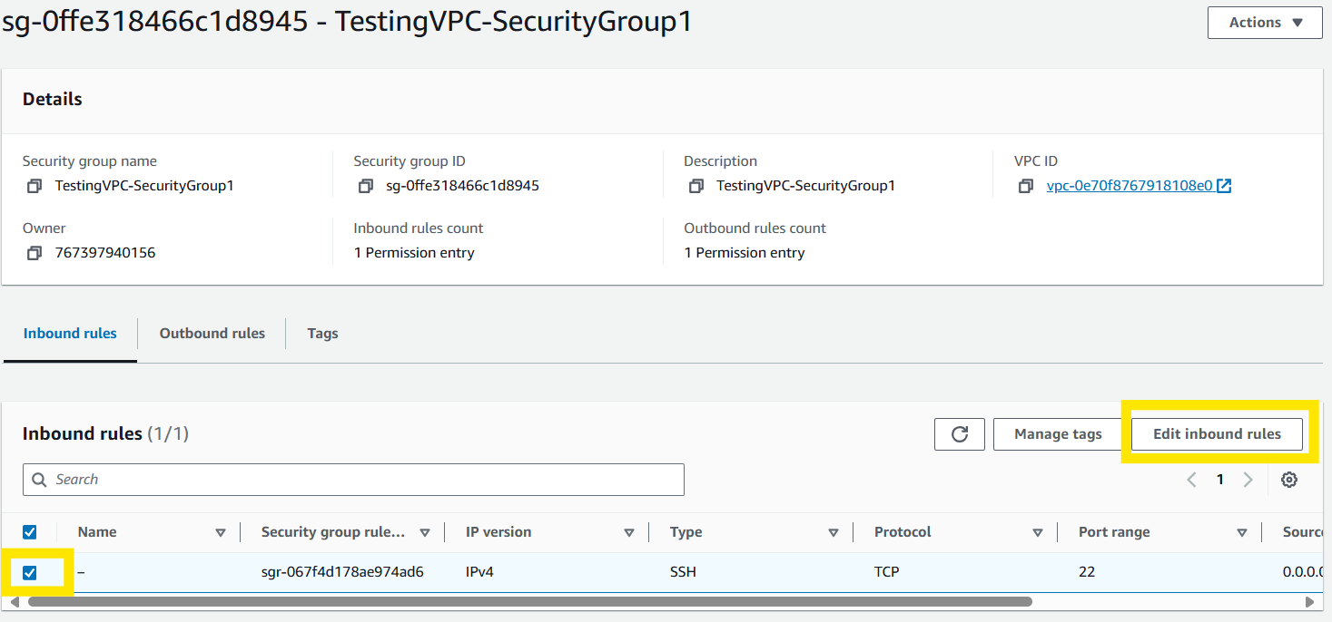
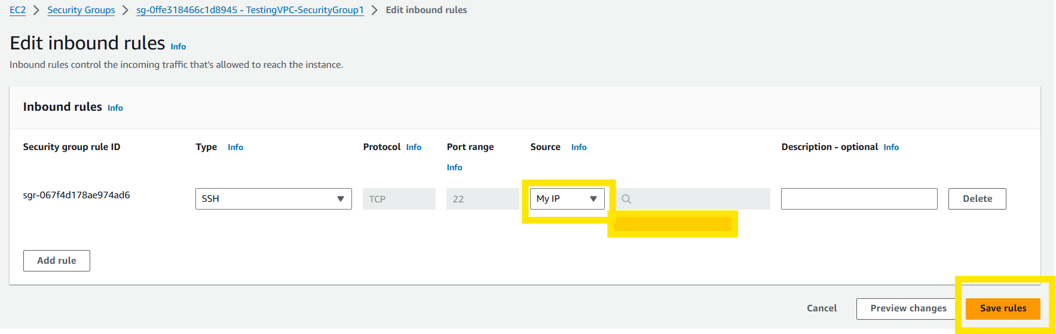
Select your default inbound rule and then select Edit inbound rules.
Let’s make the current inbound rule more secure by changing the source to My IP, then click Save rules.

Slide 6
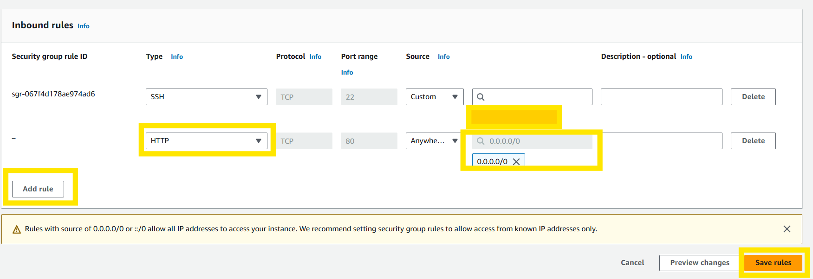
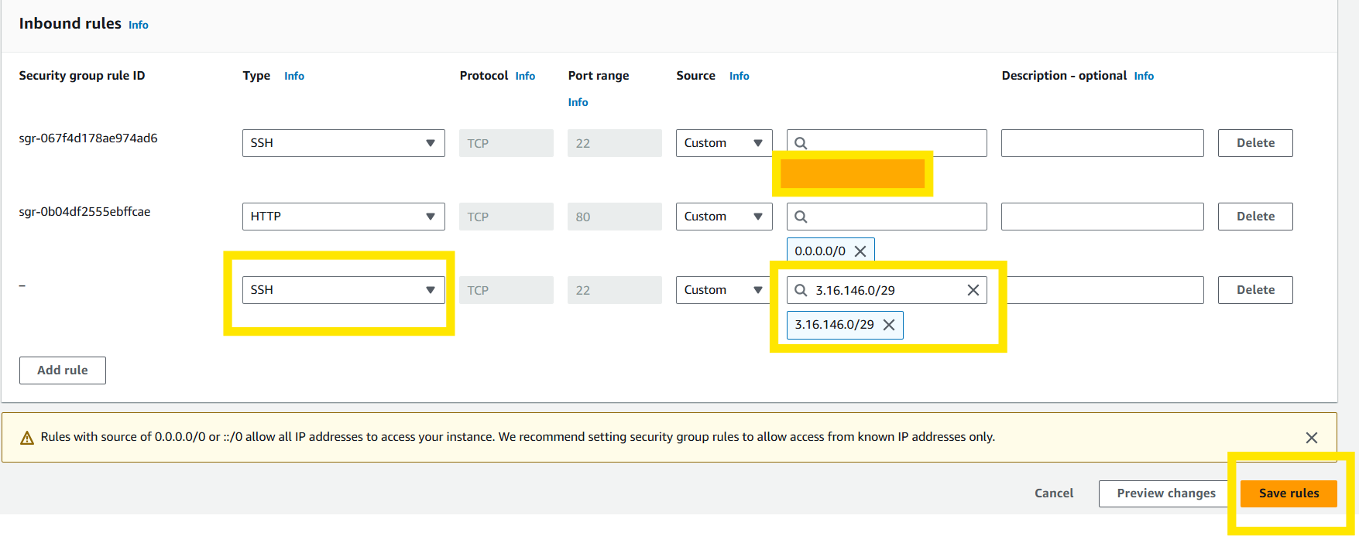
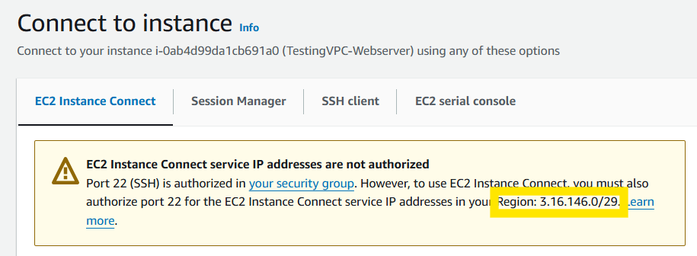
Go back in to edit rules, select Add rule, change type to HTTP, Source to 0.0.0.0/0, and select Save rules. This allows your site to be accessed via the internet. Add a third (3rd) inbound SSH rule to allow your EC2 Connect to connect to your instance. Obtain your EC2 Connect area’s ip address and put in in the same as you did for your personal ip address.

Slide 7
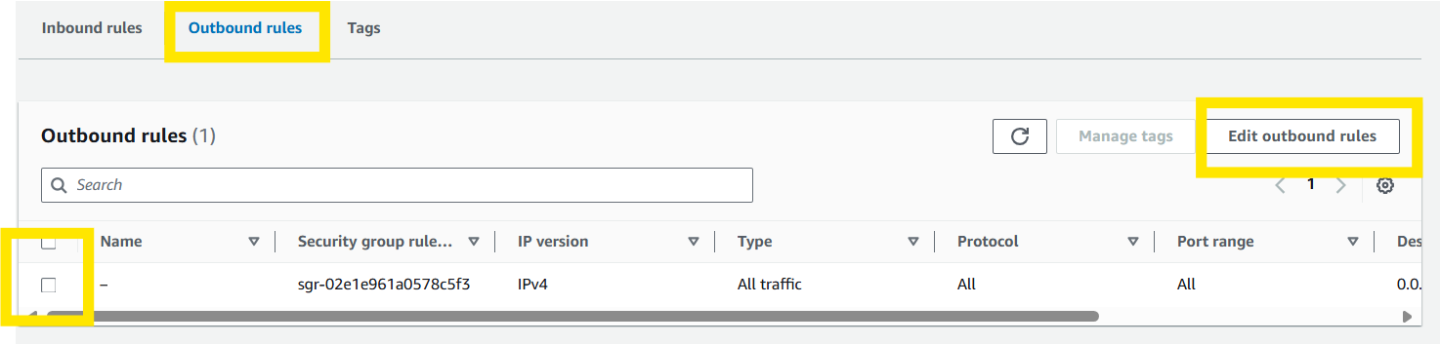
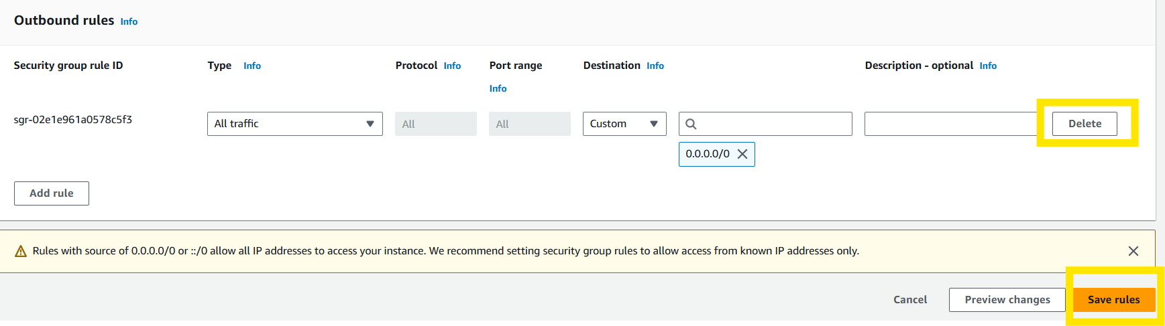
Our server is a stateless server and being so we do not need an outbound rule as it will use the inbound rules. Select the outbound rules, edit outbound rules, select delete, and save.

Slide 8
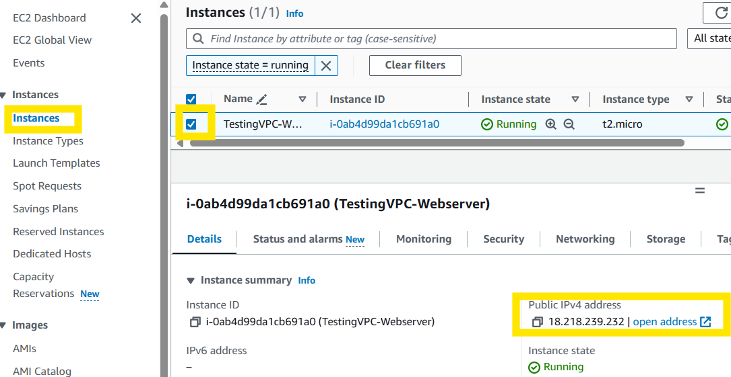
Go to Instances, click on your Instance, and select open address to open the website.

Slide 9
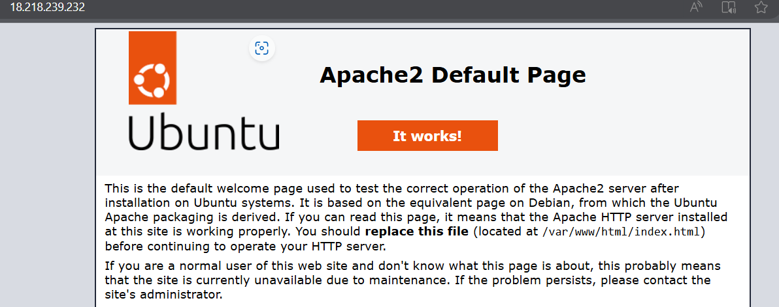
We can access the site! It may take a moment or two for the access to update so if it doesn’t work give it a few minutes and comeback and try again.

Slide 10
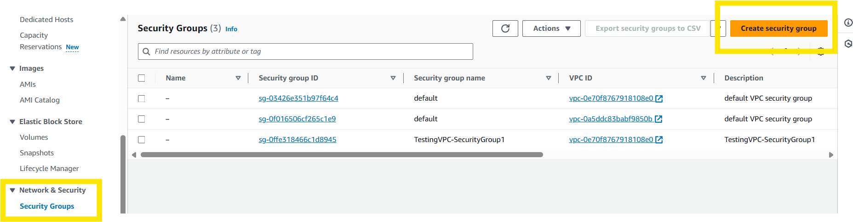
In your Instances Dashboard go to Security Groups and select Create security group.

Slide 11
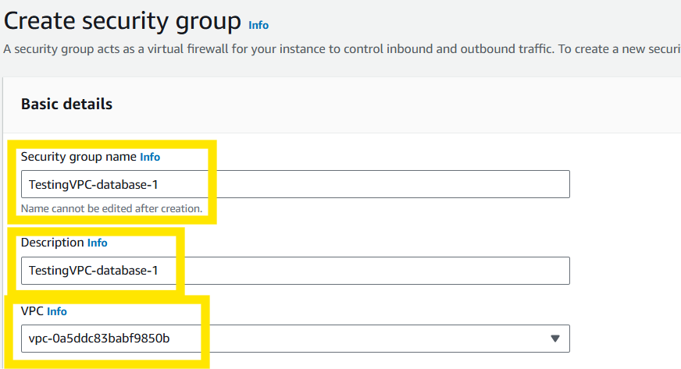
In your Instances Dashboard go to Security Groups and select Create security group.
Name your security group, provide a description, and select your VPC that you have been working on.

Slide 12
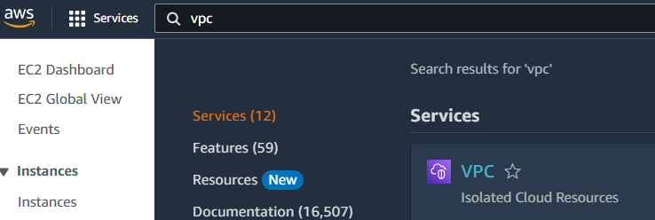
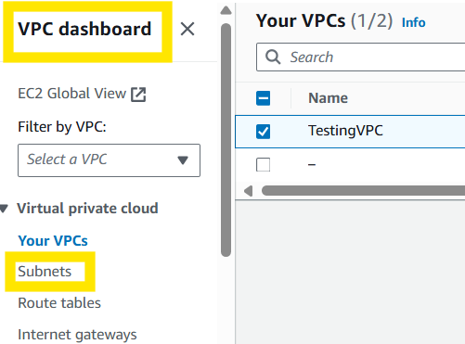
Go to your VPC Dashboard.
On VPC dashboard go to subnets.

Slide 13
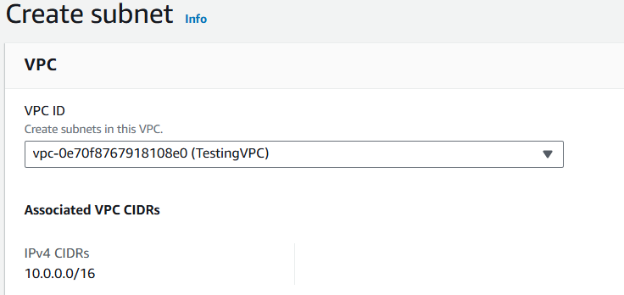
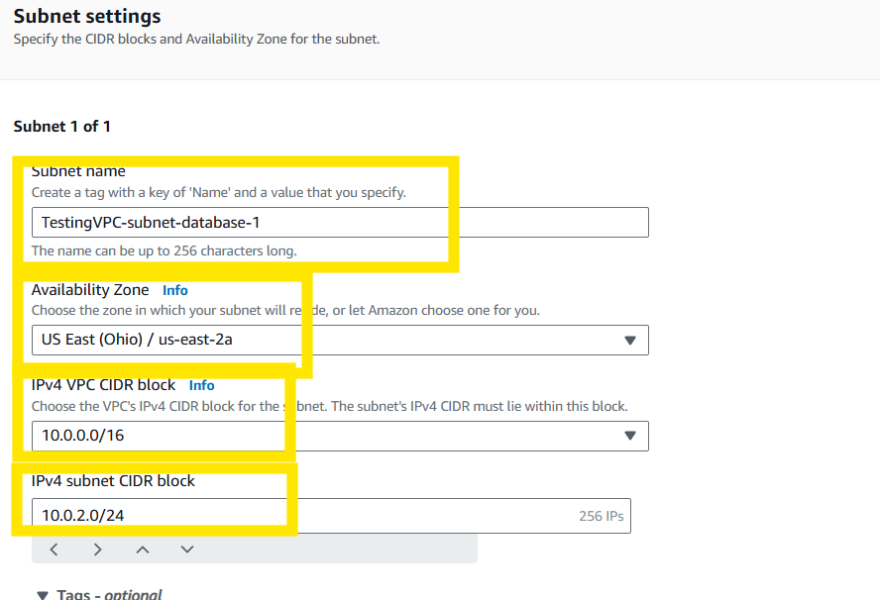
Select your VPC.
Fill in the subnet name, availability zone, IPV4 subnet CIDR block, and select Create. Do this step twice (Name second one same as first with a -2 at the end) as you need two availability zones (AZs) for redundancy and failover protection.

Slide 14
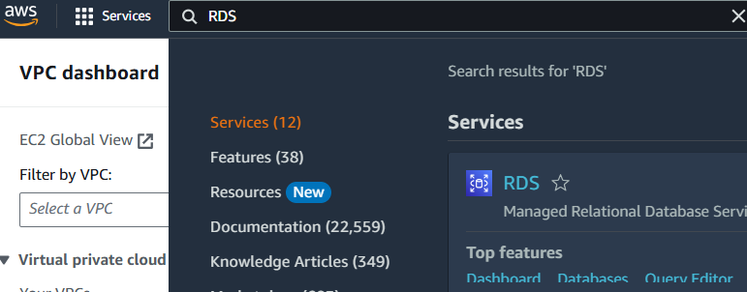
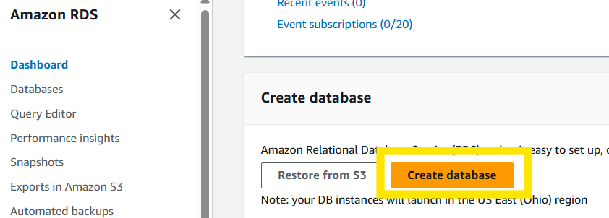
Search for Relational Database Service (RDS).
Scroll down and select Create database.

Slide 15
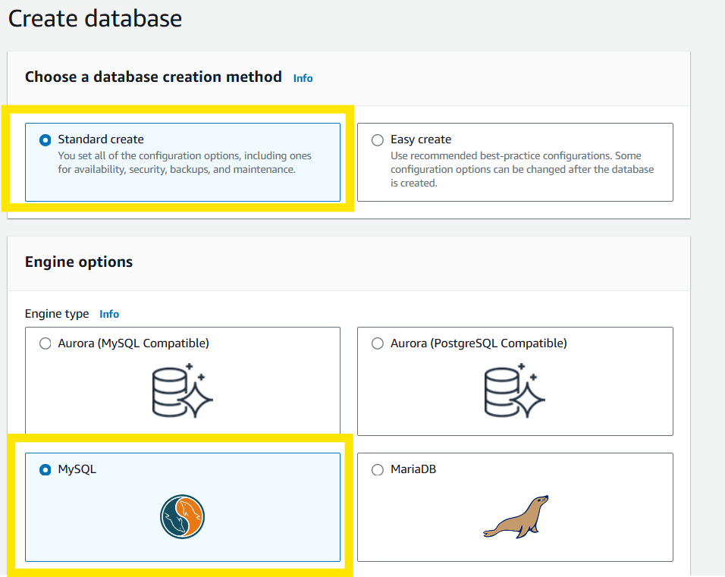
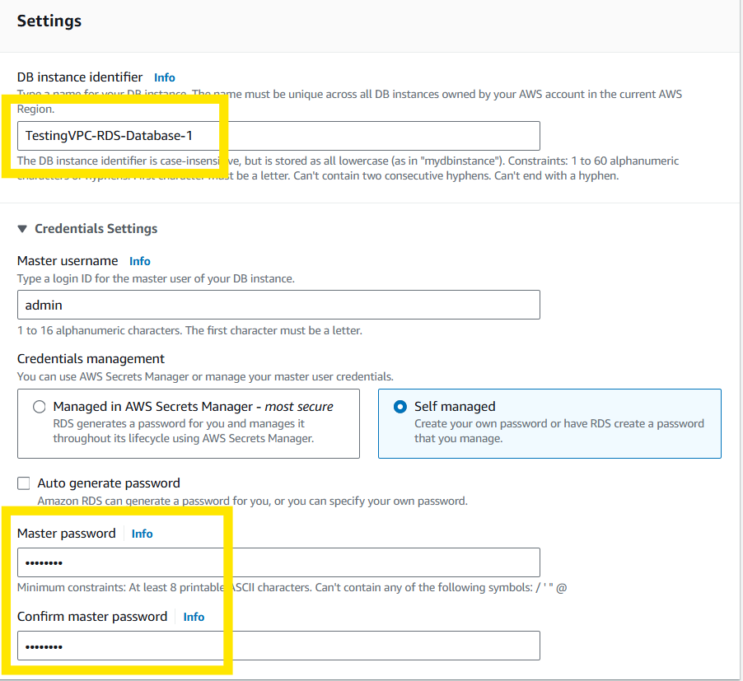
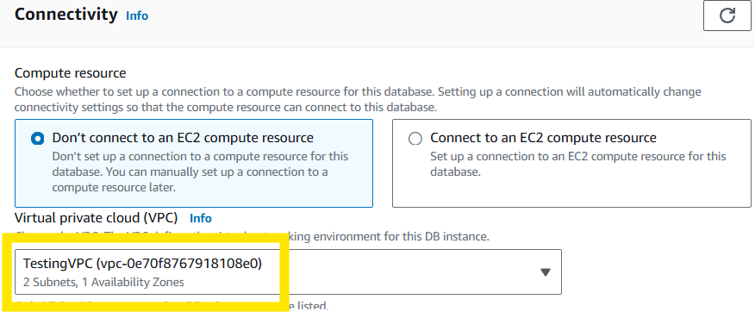
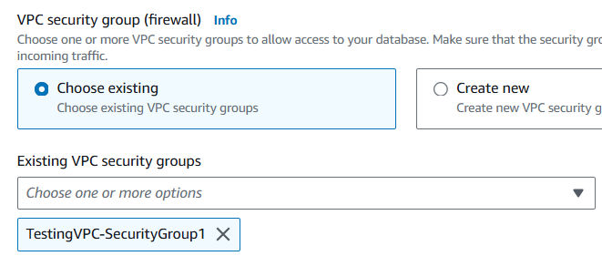
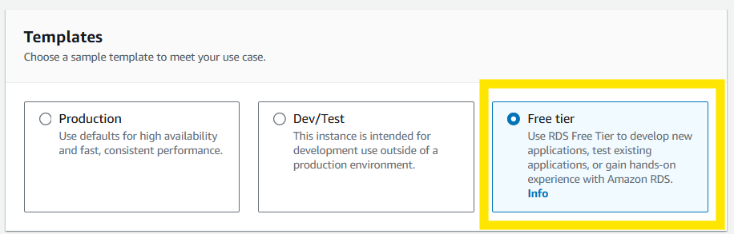
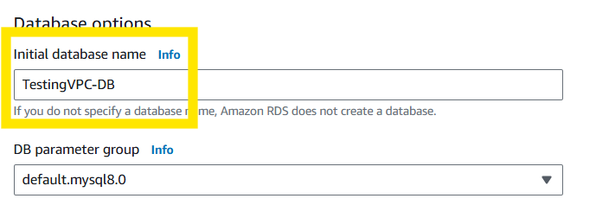
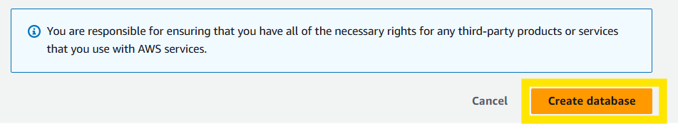
Next you will create you database by making the selections below.

Slide 16
Search for Relational Database Service (RDS).
Scroll down and select Create database.

Slide 17
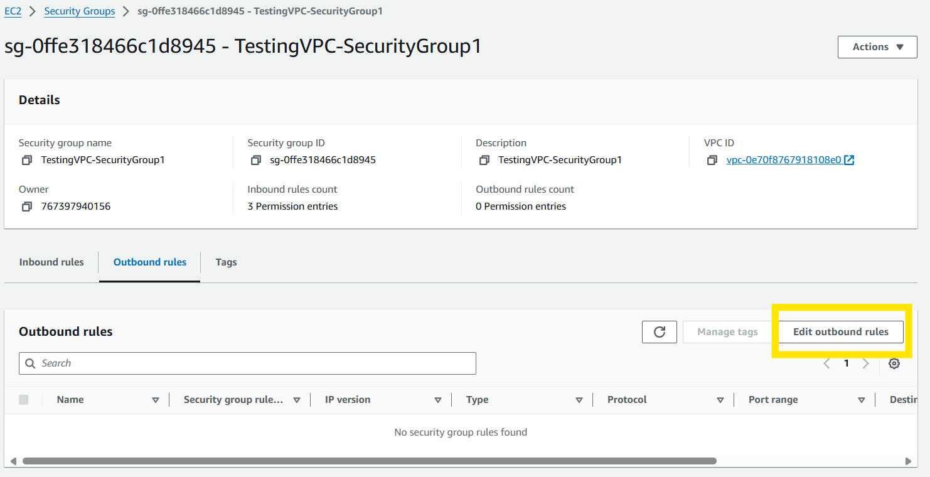
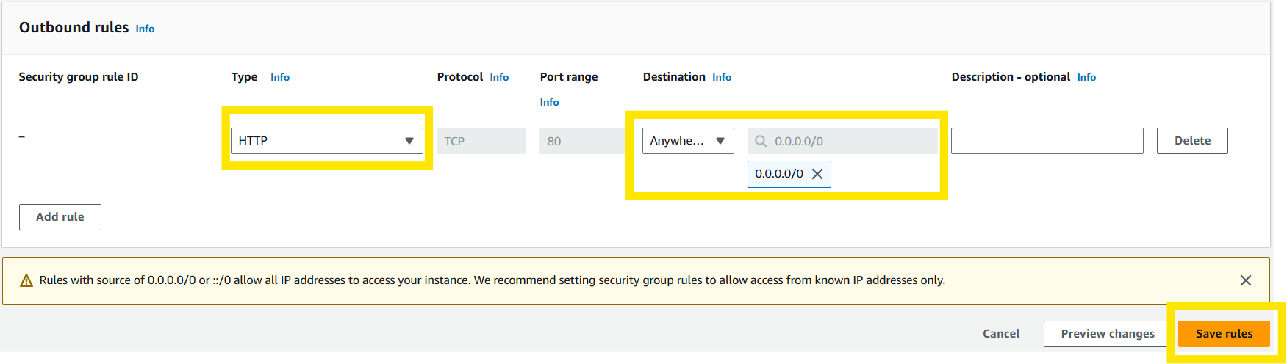
Edit your security groups outbound rules to allow access to the internet to download files (MySQL client) from the internet for installation.
Connect to your Instance via EC2 Connect same way as before.

Slide 18
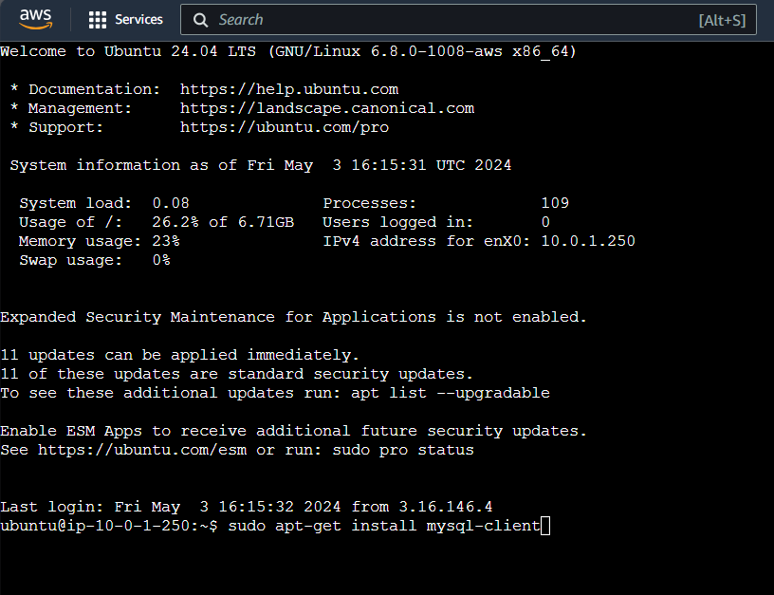
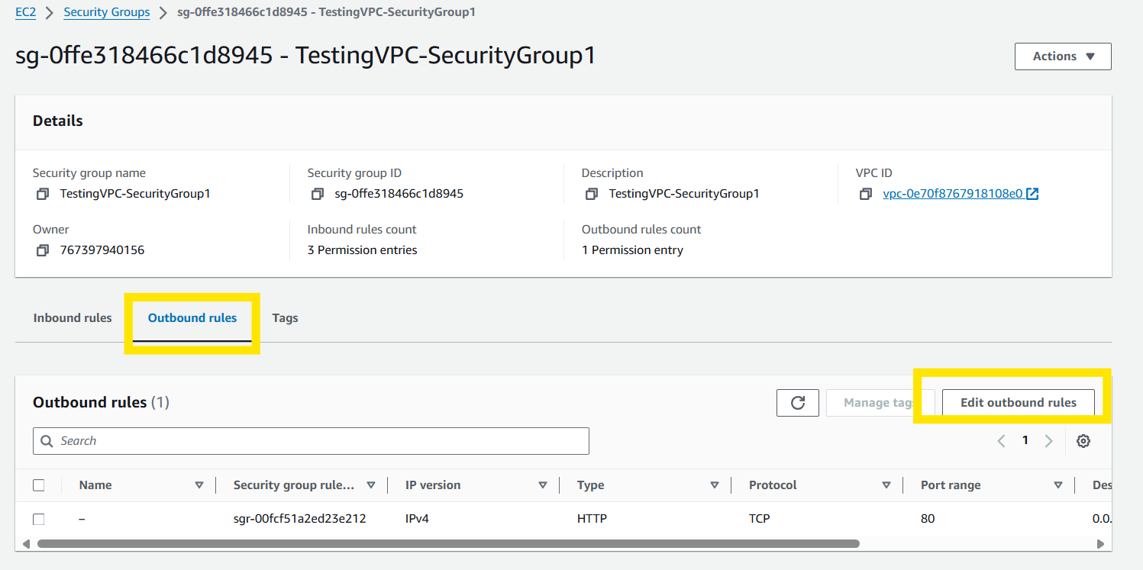
Use sudo apt-get install mysql-client to install MySQL to the database.
Once download is complete go back to outbound rules and remove the outbound rule for security.

Slide 19
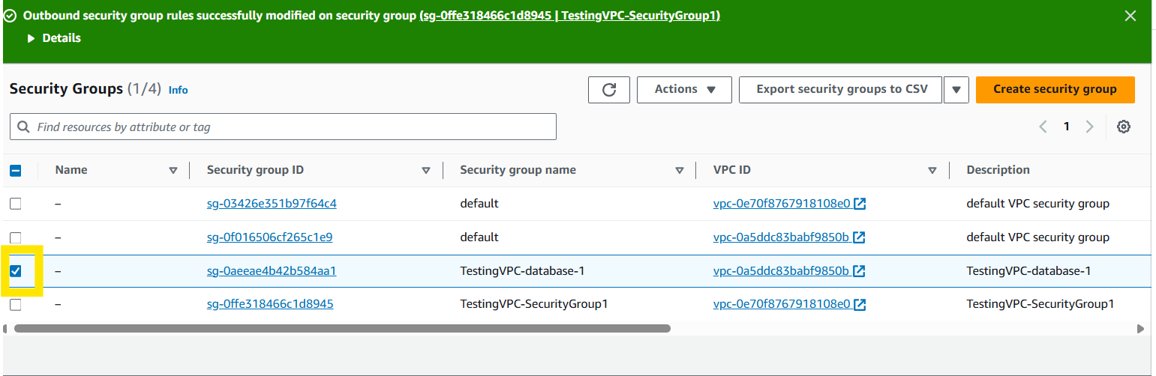
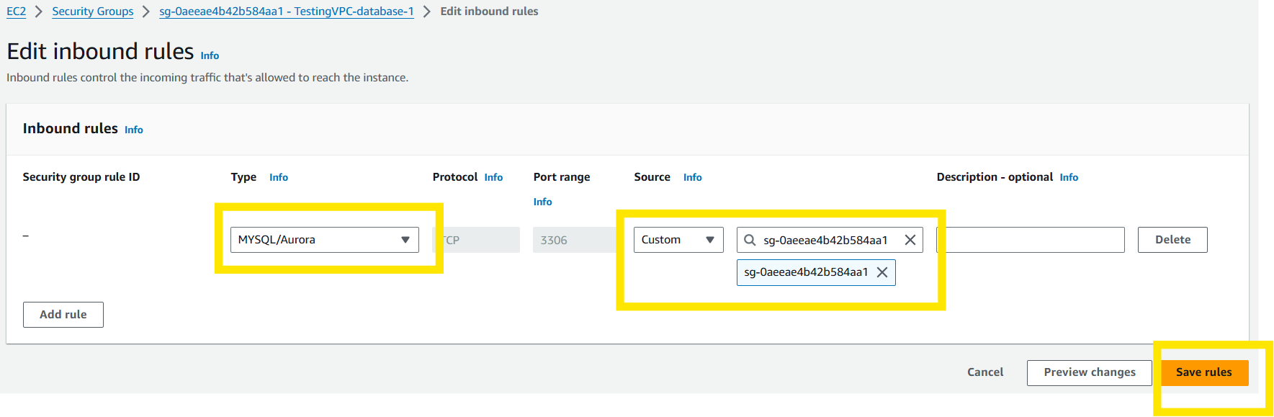
Go to security groups and click on your database security group.
Now scroll down and select edit inbound rules, add rule, and add the MySQL/Auroa rule, Custom, select your security group, and select save rules. This allows your database to connect to the server.

Slide 20
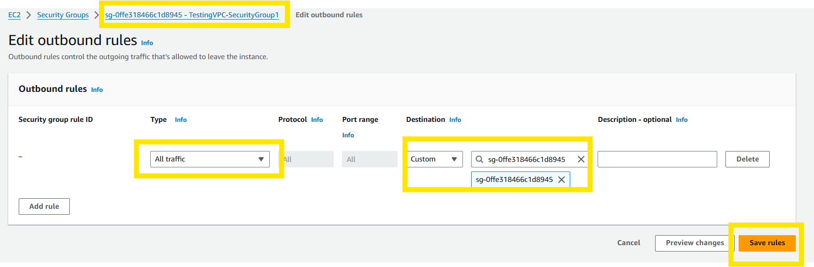
Go back to security groups and now click on the VPC security group.
Go to outbound rules and create a rule for all traffic from your database security group to travel to your VPC.

Slide 21
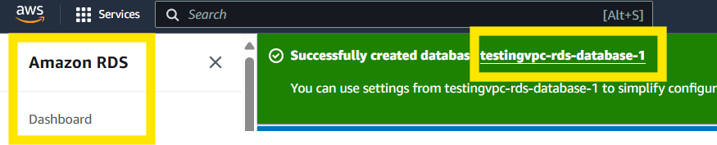
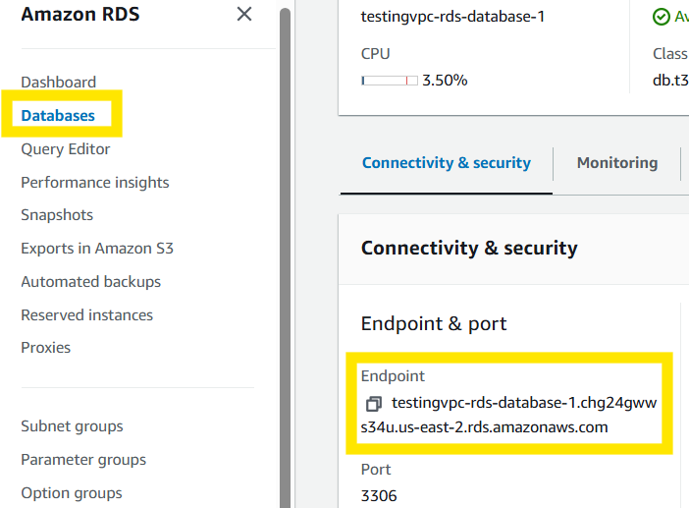
After the database has been created go to the Amazon RDS Dashboard and select your database.
Then scroll down and copy your endpoint information.

Slide 22
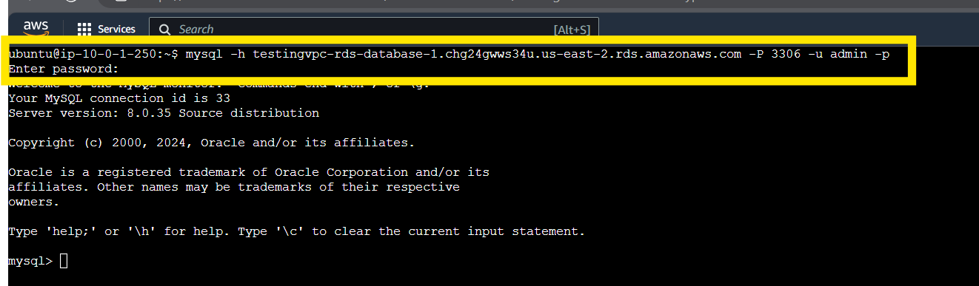
Enter the command and your password into the EC2 Connect to connect to the database. This is to verify you can connect to your database.

Slide 23


